Slide 1



UNIT 3
LESSON 9
Take action
Part 3

Slide 2
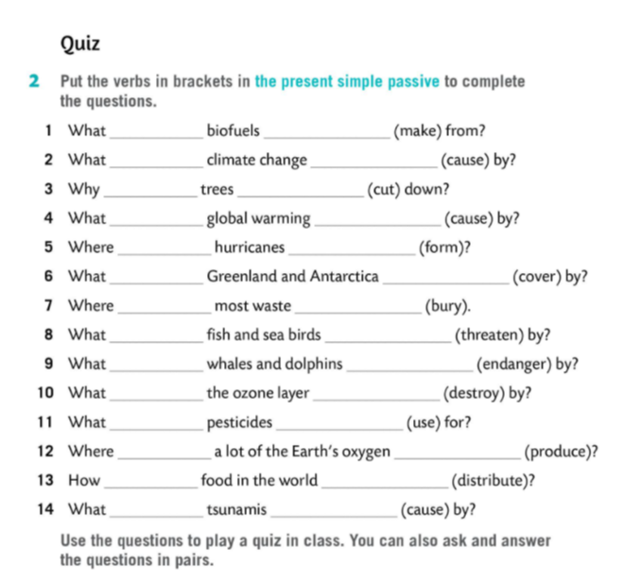
are
made
is
caused
are
cut
is
caused
are
formed
are
covered
is
buried
are
threatened
are
endangered
is
destroyed
are
used
is
produced
is
distributed
are
caused

Slide 3
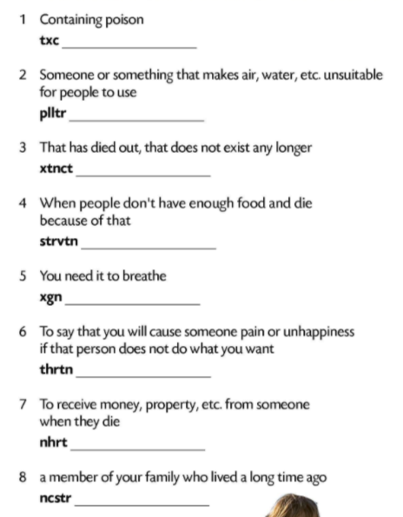
toxic
polluter
extinct
starvation
oxygen
threaten
inherit
ancestor

Slide 4
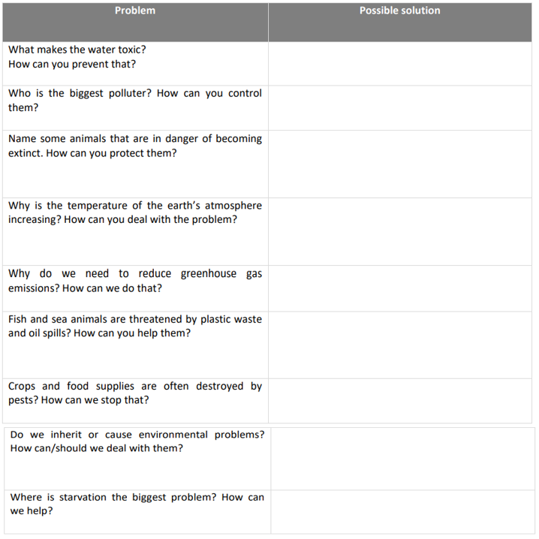

Slide 5
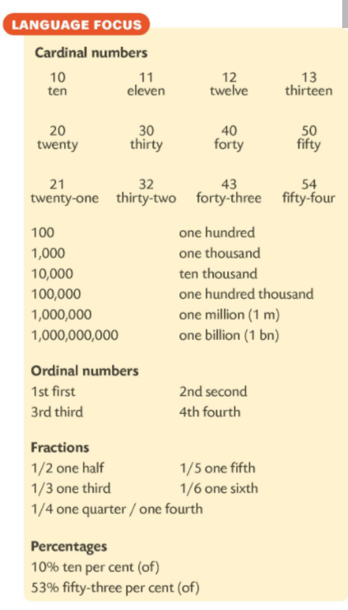

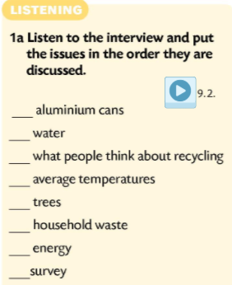

3
1
7
5
6
2
4
8

Slide 6
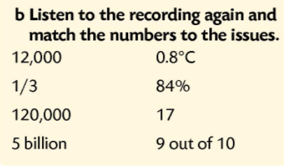
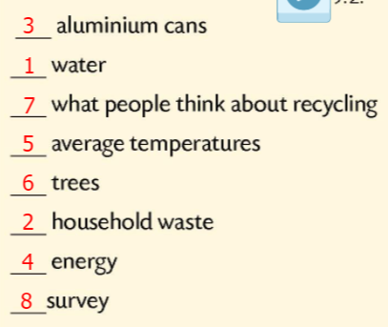
5 billion
12,000
9 out of 10
0.8˚C
17
84%
1/3
120,000

Slide 7
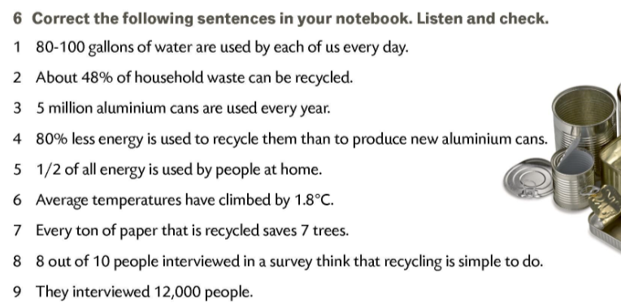
12,000
84%
5 billion
90%
1/3
0.8˚C
17 trees
hard to do
120,000 people

